Slide 1


FINAL PRESENTATION · SESSION 5
Bayesian Sensor Fusion & Gaussian Process Mapping
for Human–Robot Collaborative Hygiene Monitoring and Surface Disinfection
Case Study Assistive Robotics for Improvement of Life Quality
Presented by · Group 1
Alwa Jyoshna Vallepu Vishnu Kappala Mahesh
M.Eng. Robotics · Technische Hochschule Deggendorf
Supervisor: Prof. Dr.-Ing. Hamidreza Heidari
Bayesian Fusion + GP Hygiene Monitoring | Group 1
1

Slide 2



BACKGROUND & HISTORY
Why Disinfection Robots Need to Sense, Not Just Move
Infection control is a persistent healthcare challenge. Robots that deliver UV or spray disinfection are well established — but almost all of them verify that a path was followed, not that contamination was actually present, reduced, or removed.
No Contamination Sensing
No Verification
Operator Carries the Burden
Robots traverse a fixed path and irradiate on schedule — without sensing whether contamination is actually present.
Systems confirm a UV lamp followed its planned path, not that pathogens were actually removed from the surface.
With no probabilistic hygiene model, the human retains full cognitive responsibility for spotting contaminated areas.
Bottom line: contamination is spatially uneven, sensing is absent, and verification stops at geometry — not biology.
Bayesian Fusion + GP Hygiene Monitoring | Group 1
2

Slide 3

LITERATURE REVIEW & BIBLIOGRAPHY REPORT
Five Reviewed Works, Five Capability Gaps
Review scope: shared autonomy disinfection, verifiable UV disinfection, vision-based mobile manipulation, device reprocessing, and HRC adoption in healthcare (2021–2023), plus the foundational 2006 Gaussian Process reference.
Reviewed Work | Contam. Sensing | Cleanliness Verification | Sensor Fusion | Spatial Mapping | Uncertainty Quantified
[1] Sanchez & Smart (2021) | ✗ | ✗ | ✗ | ✗ | ✗
[2] Sanchez & Smart (2022) | ✗ | ◐ | ✗ | ✗ | ✗
[3] Baumgarten et al. (2022) | ◐ | ✗ | ✗ | ✗ | ✗
[4] RODI / JARVIS (2021) | ✗ | ✗ | ✗ | ✗ | ✗
Proposed Framework | ✓ | ✓ | ✓ | ✓ | ✓
Gaps Closed by the Proposed Method
No contamination estimation
→ Bayesian multi-sensor fusion
Weak, path-level verification
→ Per-patch posterior + uncertainty
Sensor fusion used in isolation
→ Closed-form inverse-variance fusion
[5] Weerarathna et al. (2023) is a narrative review — framed for human-factors context, not scored technically.
No spatial coverage of unobserved areas
→ GP regression w/ RBF kernel
HRC is perception-limited
→ Uncertainty-aware HRC decision rules
Bayesian Fusion + GP Hygiene | Group 1
3

Slide 4




PROJECT OVERVIEW
System Architecture — Four Sequential Layers
1. Sensing
2. Fusion
3. Mapping
4. Decision
›
›
›
Fluorescence (T1, T2) and ATP (T7) sensors — real measured RLU values from published research.
Bayesian multi-sensor fusion → per-patch posterior mean and variance, weighted by inverse variance.
RBF-kernel Gaussian Process interpolates contamination across observed and unobserved patches.
Priority scoring, adaptive UV dose, and threshold-based HRC collaboration rules.
Modular design: each layer can be updated or replaced independently without affecting the others.
Bayesian Fusion + GP Hygiene Monitoring | Group 1
4

Slide 5
DEVELOPMENT PROCESS
Modelling Approach — Fusion & Spatial Mapping
Bayesian Multi-Sensor Fusion
Gaussian Process Spatial Mapping
z_m,i = f_i + ε_m , ε_m ~ N(0, σ²_m)
RBF kernel: k(xᵢ,xⱼ) = σ²_f · exp(−‖xᵢ−xⱼ‖² / 2l²)
Fused precision: σ⁻²_fused = σ⁻²₀ + Σ σ⁻²_m
Length-scale l = 1.0, Signal variance σ²_f = 1.0
Fused mean: μ_fused = σ²_fused · (μ₀/σ²₀ + Σ z_m/σ²_m)
Distance | Correlation | Meaning
d = 1 (adjacent) | 0.607 | Strongly correlated
d = √2 (diagonal) | 0.368 | Moderately correlated
d = 2 (two apart) | 0.135 | Weakly correlated
Source | σ² | Precision | Note
Fluorescence (T1,T2) | 0.01 | 100 | Most precise sensor
ATP (T7) | 0.02 | 50 | Real RLU value, Niephaus 2024
Prior belief | 0.09 | 11.1 | Neutral start, μ₀ = 0.5
Result: Every patch — observed or not — receives a mean estimate and calibrated uncertainty. Unobserved patches inherit higher variance, exactly where human confirmation should be sought. 9/9 spatial coverage achieved vs. 3/9 for a Kalman filter.
Key guarantee: σ²_fused < σ²_m for every sensor m — adding sensors never increases uncertainty, even noisy ones. Result: 87.3% average variance reduction.
Bayesian Fusion + GP Hygiene Monitoring | Group 1
5

Slide 6
DEVELOPMENT PROCESS
Roadmap — From Mathematical Model to Hardware
1
DONE
›
2
Next
›
3
Final
Analytical Validation
Simulation
Hardware Calibration
Closed-form Bayesian fusion, RBF-kernel GP formulation, 3×3 grid case study, sensitivity analysis.
MATLAB 11-step pipeline: Bayesian fusion, GP mapping (9/9 coverage), Kalman comparison, HRC decisions, Gaussian UV cleaning.
Real fluorescence / hyperspectral sensor calibration replacing assumed noise values.
We are here — analytical modelling and MATLAB simulation are complete.
Bayesian Fusion + GP Hygiene Monitoring | Group 1
6

Slide 7
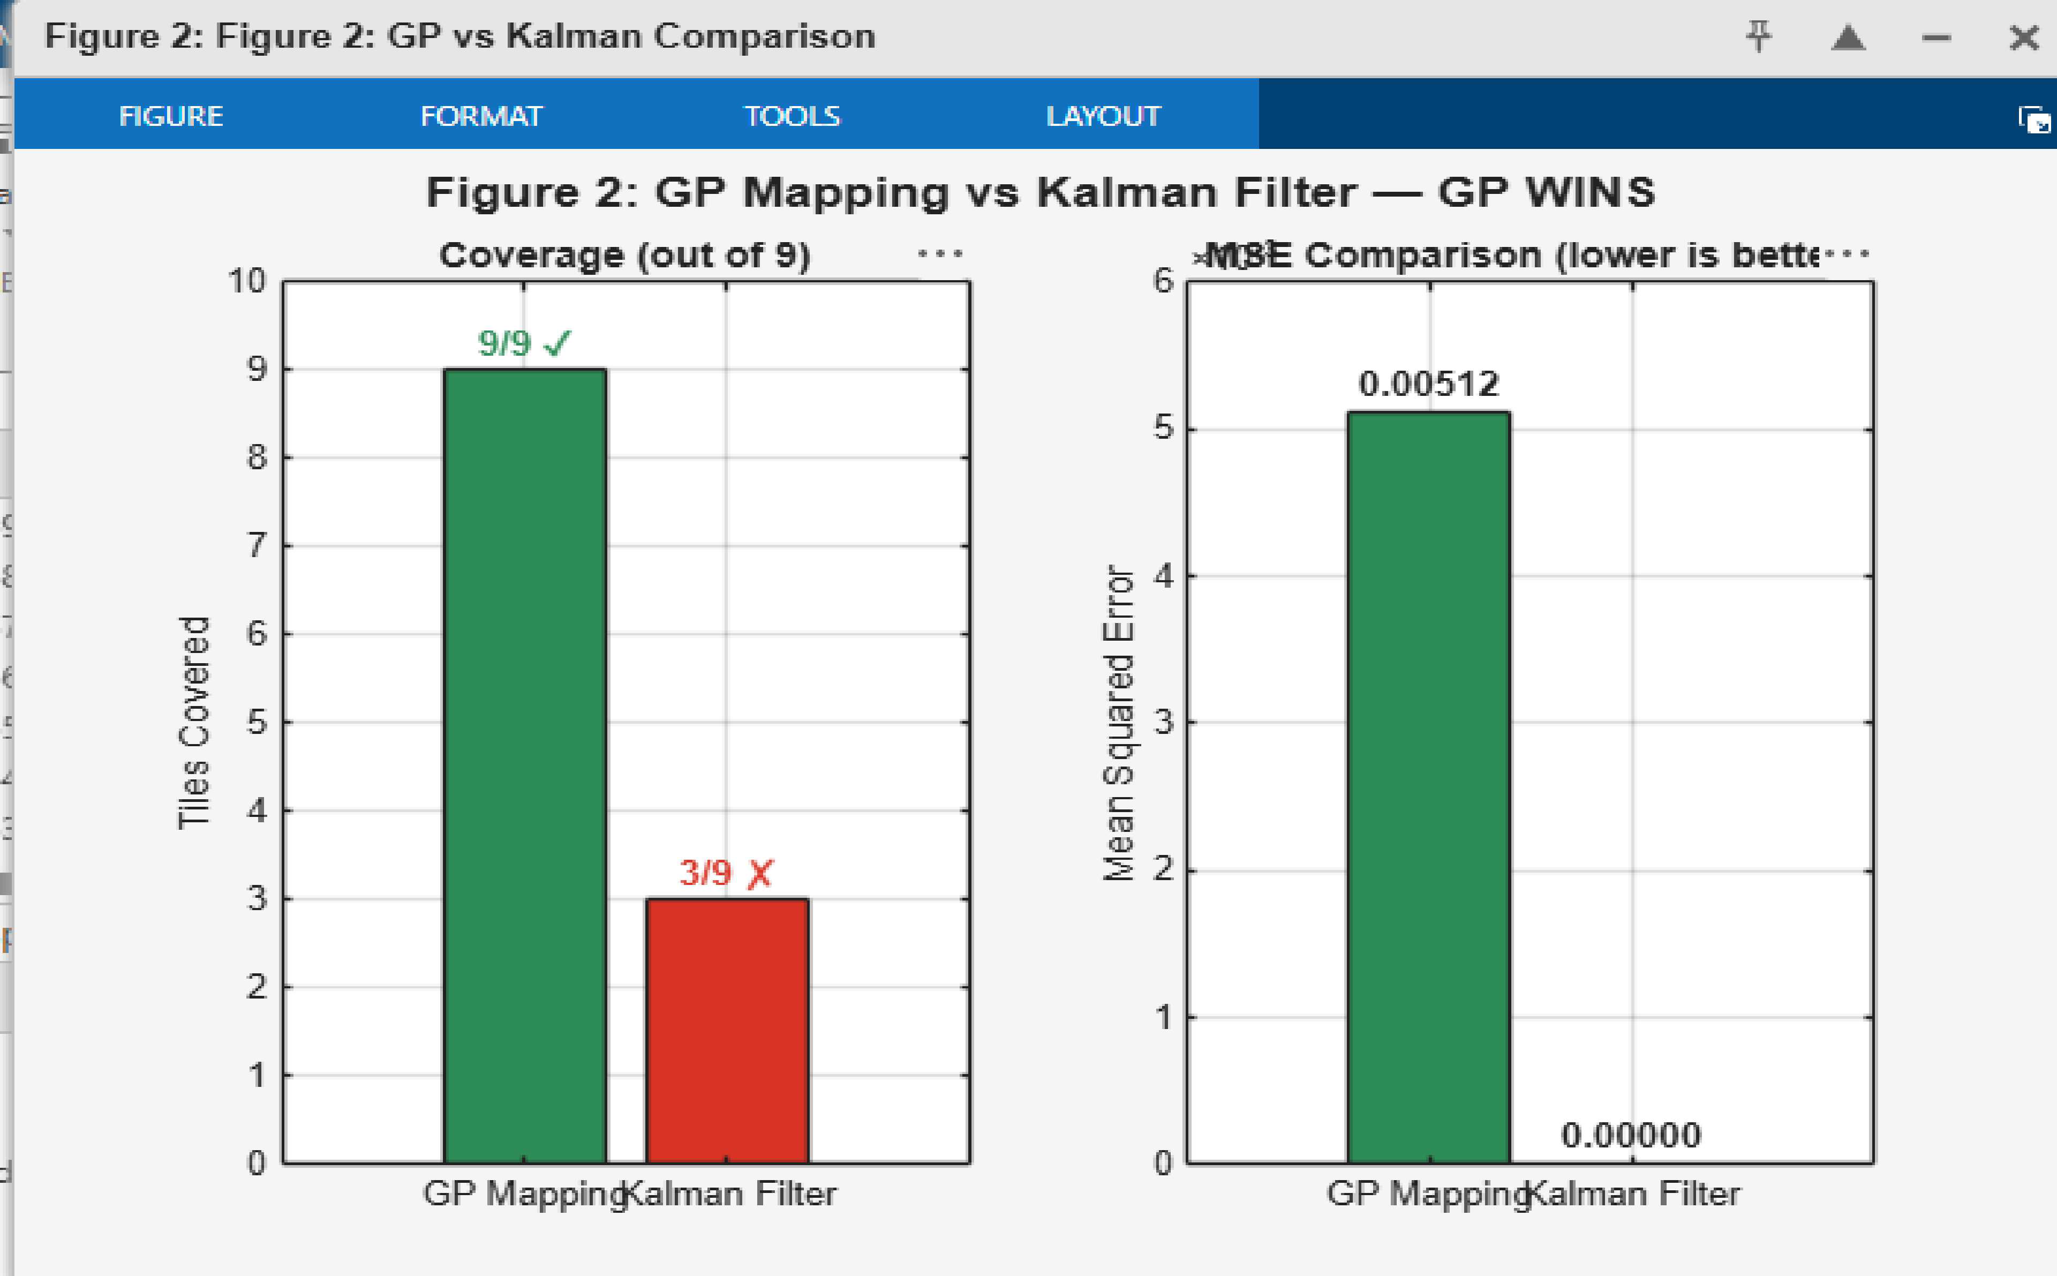
RESULTS & DISCUSSION
Validated Performance on a 3×3 Surface-Grid Case Study
87.3%
9 / 9
2×
51.1%
Uncertainty reduction
Spatial coverage
Fluorescence precision
UV cleaning efficiency
prior 0.09 → fused 0.011
vs. 3/9 for Kalman filter
vs. ATP — most accurate sensor
T7 door handle 100% cleaned
Discussion
Real sensor inputs: T1 Toilet = 0.75, T2 Chair = 0.13 (Fieldhouse 2025), T7 Door handle = 0.91 (Niephaus 2024). GP estimated the remaining 6 blocked tiles via RBF kernel.
HRC decisions:
T7 → DISINFECT NOW, T1 → CALL HUMAN, remainder → MONITOR.
Caveat:
results are analytical / simulation validation.
GP Mapping vs. Kalman Filter — coverage 9/9 vs 3/9, MSE 0.00512
Bayesian Fusion + GP Hygiene Monitoring | Group 1
7

